Slide 1


K.RAMAKRISHNAN COLLEGE OF TECHNOLOGY (AUTONOMOUS), TRICHY
Analyzing Age-Wise Distribution of a Population Using R
PRESENTED BY
NETHAJI J
(2303811724321077)

Slide 2
PRESENTATION OVERVIEW
Problem Identification and Analysis
Objective
Proposed Woke Architecture & Module Design
Block diagram of proposed system
Module Description
Module Implementation
R Programming Implementation
Source Code
Output Screenshot
Conclusion

Slide 3
🔍Problem Identification and Analysis
Many government and private organizations need to understand the age structure of a population for planning.
Raw population data can be large and complex, making it hard to interpret age-wise distribution.
Without analysis, it's difficult to spot trends like aging populations, youth bulges, or dependent age groups.
Key Challenge: Transforming raw population data into meaningful insights by age group.

Slide 4
🎯 OBJECTIVE
Classify the population into age groups (e.g., 0-14, 15-24, 25-44, 45-64, 65+).
Visualize the distribution using appropriate charts like histograms or bar graphs.
Identify trends such as aging populations, youth dominance, or workforce size.
Generate summary statistics (mean, median, percentage distribution).
Compare different regions or time periods if applicable.

Slide 5
Proposed system
Interactive Age Group Analysis – Users can filter and analyze population data by custom age ranges in real time.
Automated Visualization – The system creates dynamic bar charts, pie charts, and histograms to clearly display age distribution.
Statistical Summary Generation – Provides key demographic metrics like total count, percentage, mean, and median age.

Slide 6
BLOCK DIAGRAM
Data Collection
Data Preprocessing
Age Grouping
Data Visualization
Statical Analysis
Insights & Reporting

Slide 7
Module implementation
File Upload and Data Ingestion Module.
User Input Selection Module.
Data Processing and Reactive Logic Module.
Visualization Module.

Slide 8
Module Description
1.File Upload and Data Ingestion Module:
Accepts a .csv file containing population records with an "Age" column.
Reads and validates the data using read.csv().
Cleans data by removing missing or non-numeric age entries.
Transforming raw population data into meaningful insights by age group.

Slide 9
Module Description
2. User Input Selection Module:
Provides interactive UI elements (sliderInput,selectInput)
Choosing the age range for analysis.
Selecting the bin width for age grouping (e.g., intervals of 5 or 10).
Choosing the chart type (bar, pie, histogram).

Slide 10
Module Description
3. Data Processing and Reactive Logic Module:
Uses dplyr and reactive() to filter and group the data.
Computes key statistics for use.
Count and percentage of population per age group.
Mean, median, min, and max age.
Ensures dynamic updates to outputs based on user input.

Slide 11
Module Description
4. Visualization Module:
Uses ggplot2 to generate.
Bar Charts – to compare the number of people in each age group.
Pie Charts – to show percentage distribution.
Histograms – to display age frequency distribution.
Plots update in real-time based on user selections.

Slide 12
🧩R Programming Implementation
Create Population Data (Data Frame)
population_data <- data.frame(
Age = c(5, 18, 25, 40, 65, 70, 15, 30, 50, 80)
)
Categorize into Age Groups
population_data$Age_Group <- cut( population_data$Age,
breaks = c(0, 14, 24, 44, 64, Inf),
labels = c("0-14", "15-24", "25-44", "45-64", "65+")
)
Visualize the Distribution (Bar Chart,Pie Chart)
library(ggplot2)
ggplot(population_data, aes(x = Age_Group)) + geom_bar(fill = "skyblue", color = "black") +
labs(title = "Age-Wise Population Distribution", x = "Age Groups", y = "Count")
Basic Statistics
table(population_data$Age_Group) # Count of each age group prop.table(table(population_data$Age_Group)) * 100 # Percentage distribution

Slide 13
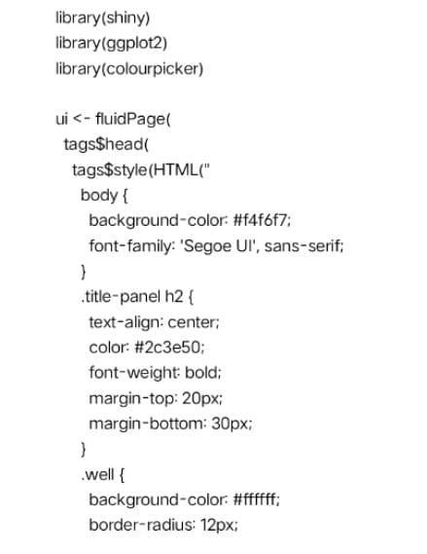
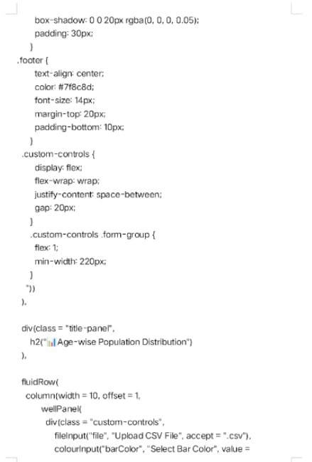
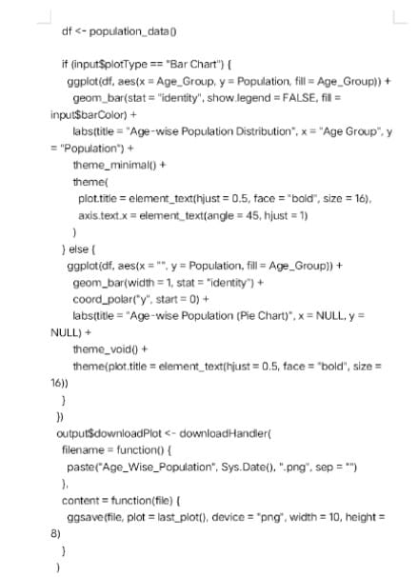
Source Code

Slide 14
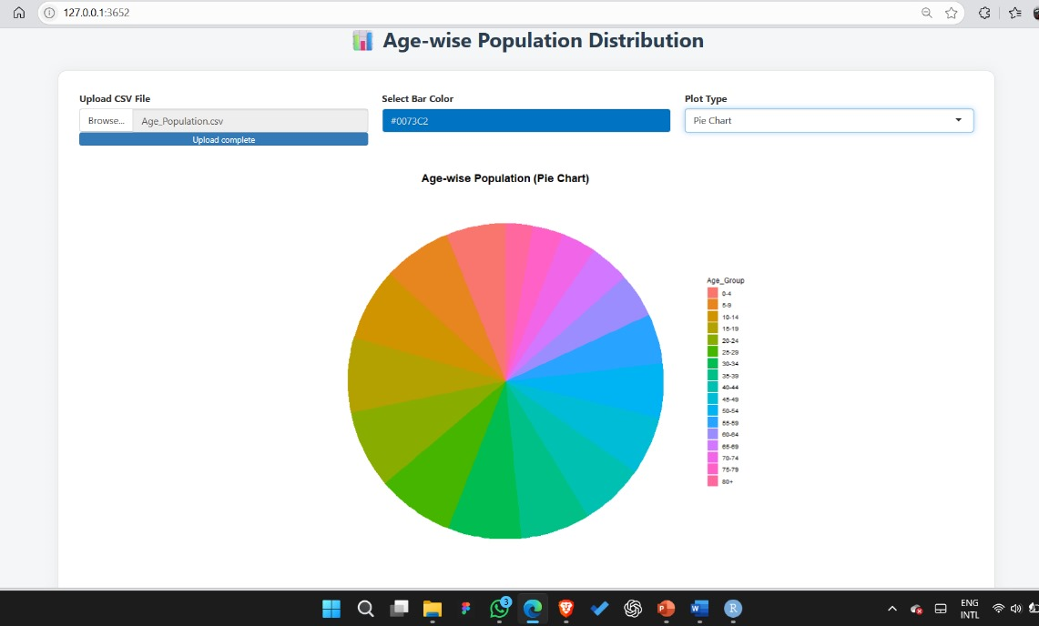
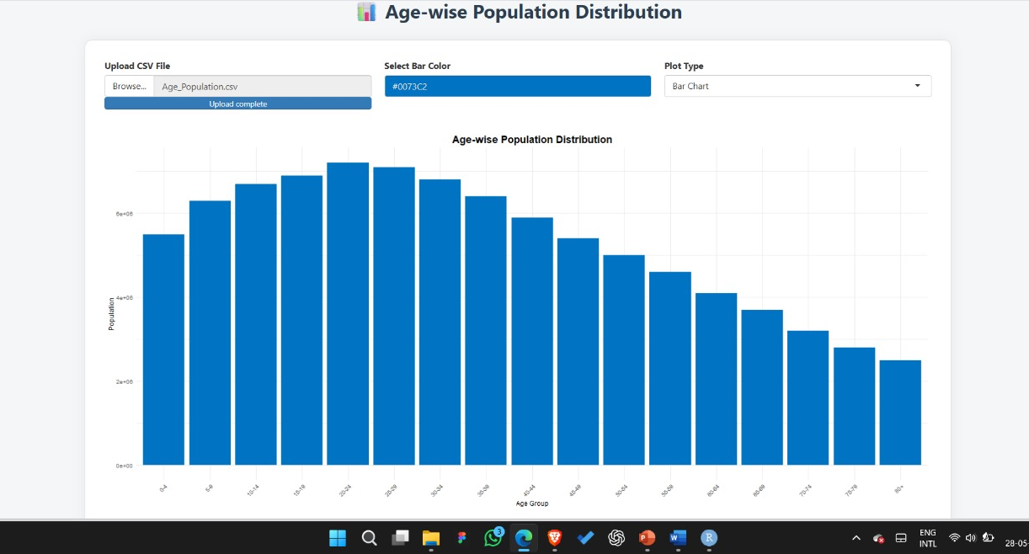
Output Screenshot

Slide 15
💡Conclusion
This project helps users easily understand how a population is spread across different age groups. By using R and Shiny, we made a tool that:
Filters and groups age data based on user input.
Shows visual charts like bar, pie, and histograms for better understanding.
Gives useful statistics such as average age and group percentages.
Overall, it’s a simple and effective system to turn raw population data into clear and meaningful insights.

Slide 16
THANK YOU

